Slide 1
Computer Network Traffic Data
Result
Communication
Process &
Analysis
Data
Collection
Business
Questions
20 November 2019 @ Telus

Slide 2


Next 20 minutes
Questions
Data
Methods
Results
Discussion
Conclusion

Slide 3


Questions
"odd" activity/suspicions about a machine's behavior:
Date : IP
08-24 : 1
09-04 : 5
09-18 : 4
09-26 : 3 6
When were the devices compromised by bot activity? Or when a compromise has occurred by a change in the pattern of communication?

Slide 4
2. Data
Computer Network Traffic Data with
A ~500K CSV of some historical real network traffic data
10 local workstation IPs
Over a three month period.
Half of the IPs were compromised
~21K rows
Four columns:
date: yyyy-mm-dd
l_ipn: local IP
r_asn: remote ASN
f: flows – i.e., count of connections by day

Slide 5







3. Methods
Collect
Clean
Transform
Analyze
Present

Slide 6


4. Results
Tableau public:
https://public.tableau.com/profile/peter.le6443#!/vizhome/ComputerNetworkTrafficData/OverallClusters
Github:
https://github.com/peterquynhle/Computer-Network-Traffic-Data
Notes:
Differences Data Analyst (DA)vs. Data Scientist (DS)

Slide 7
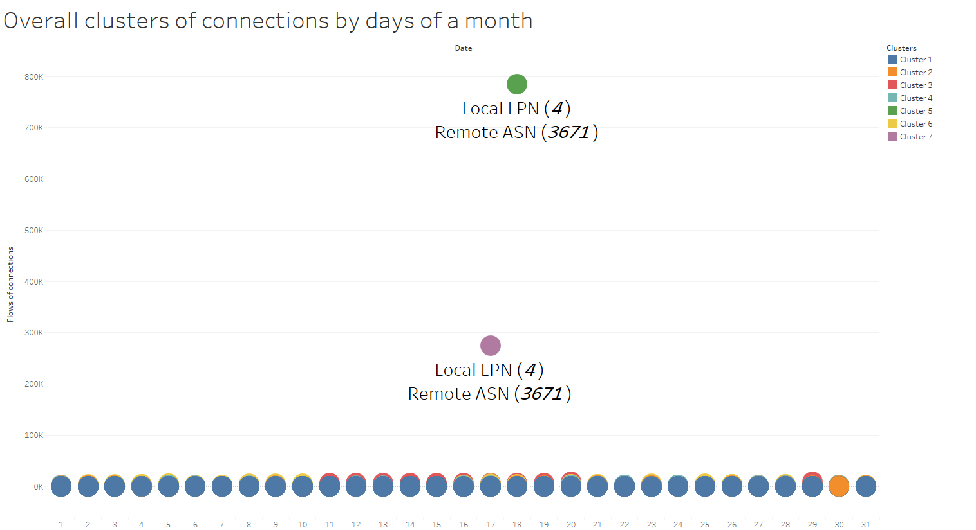
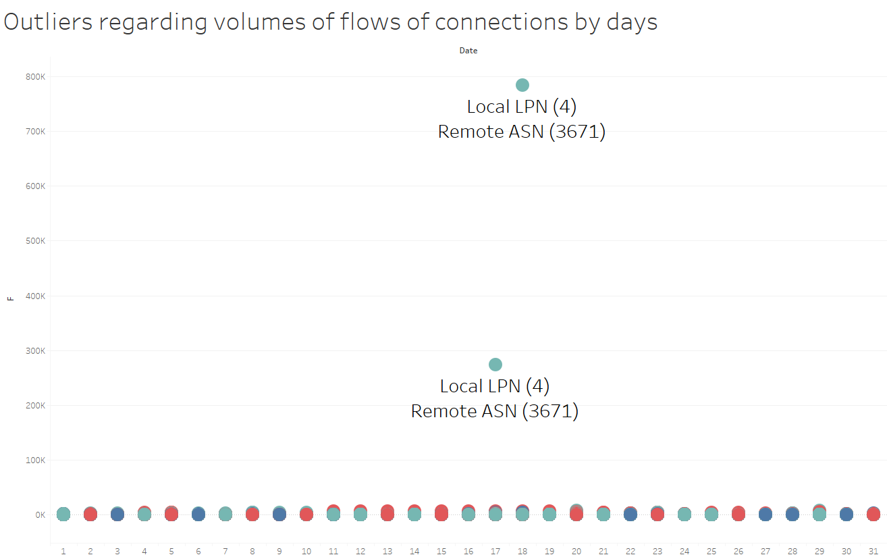
4. Results (1)
Notes:
Differences Data Analyst (DA)vs. Data Scientist (DS)

Slide 8
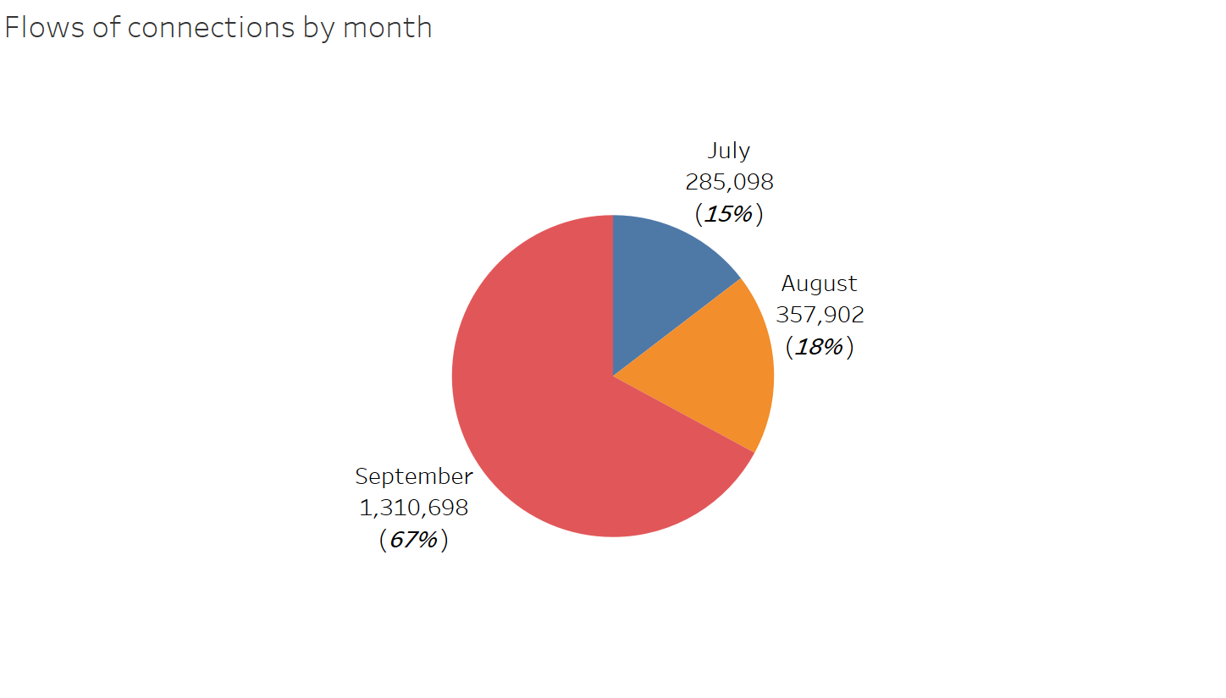
4. Results (2)
Notes:
Differences Data Analyst (DA)vs. Data Scientist (DS)

Slide 9
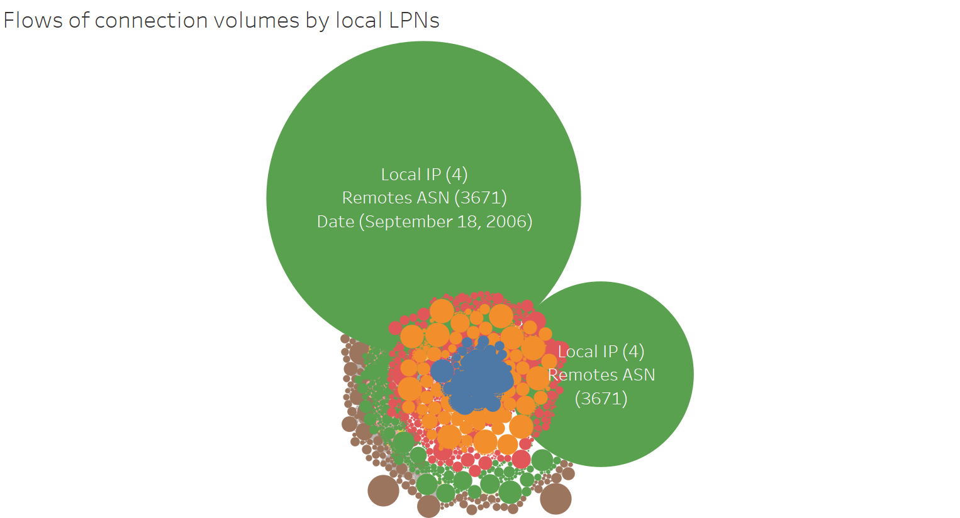
4. Results (3)
Notes:
Differences Data Analyst (DA)vs. Data Scientist (DS)

Slide 10
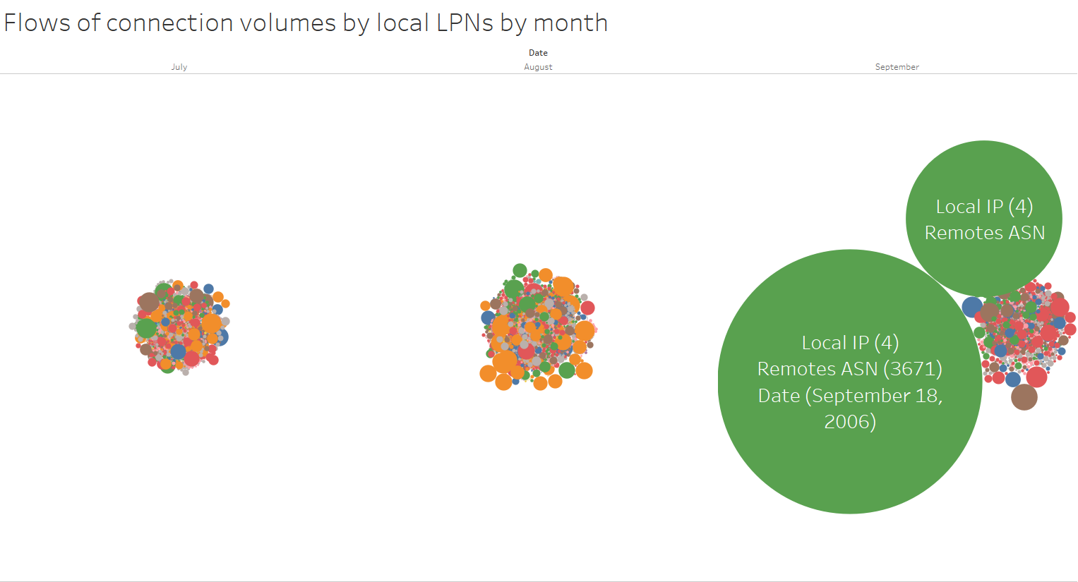
4. Results (4)
Notes:
Differences Data Analyst (DA)vs. Data Scientist (DS)

Slide 11
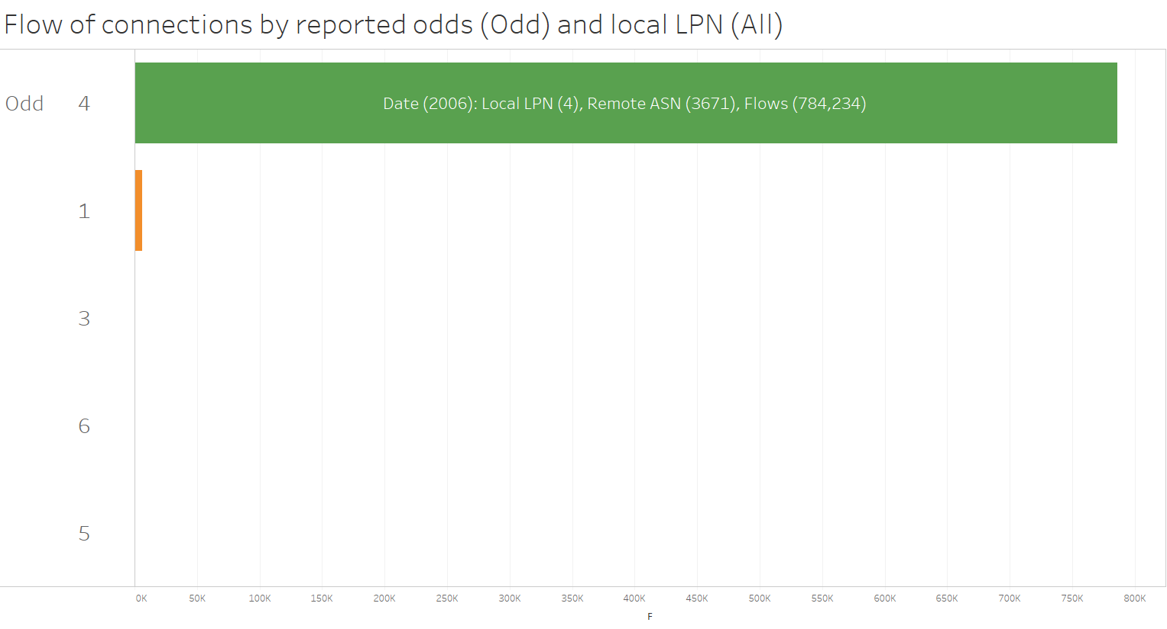
4. Results (5)
Notes:
Differences Data Analyst (DA)vs. Data Scientist (DS)

Slide 12
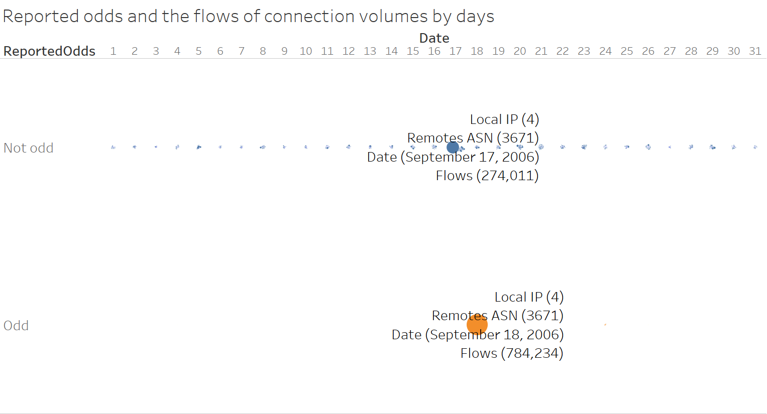
4. Results (6)
Notes:
Differences Data Analyst (DA)vs. Data Scientist (DS)

Slide 13
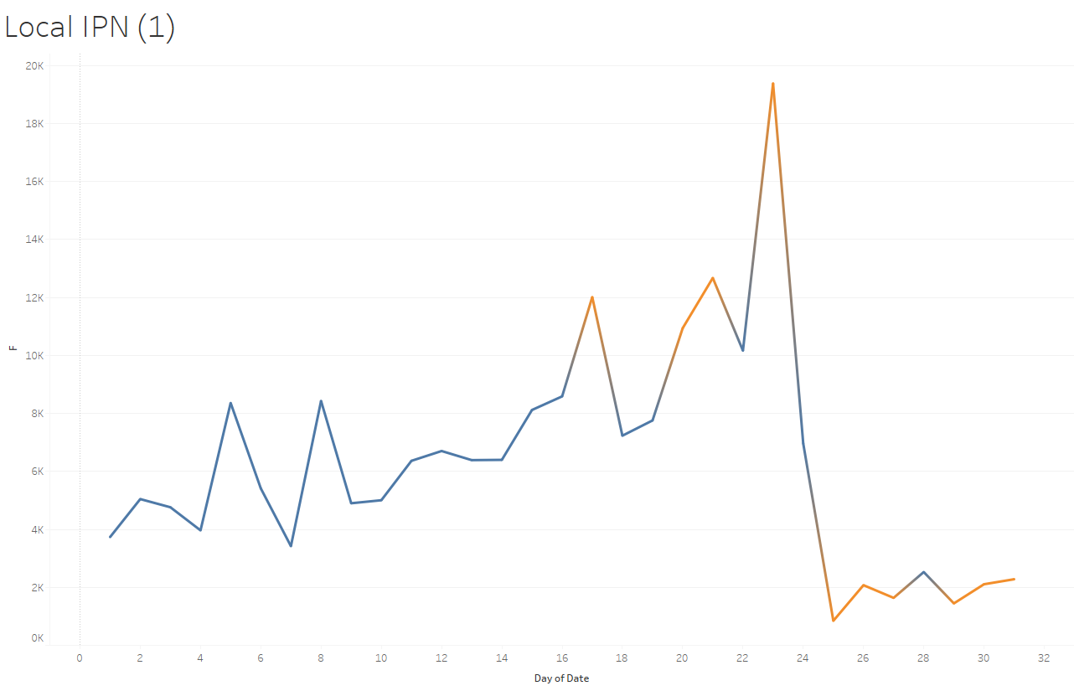
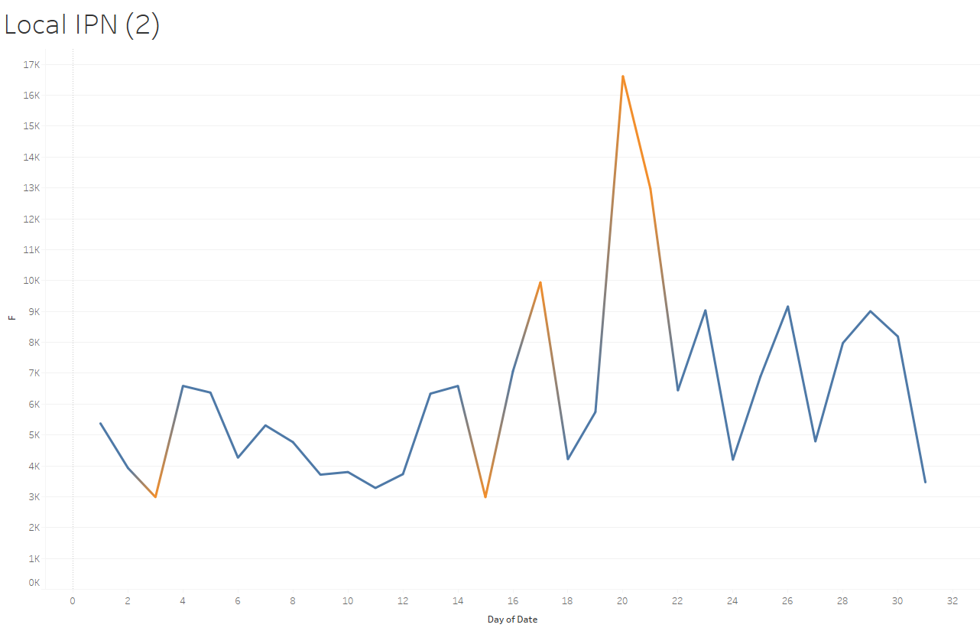
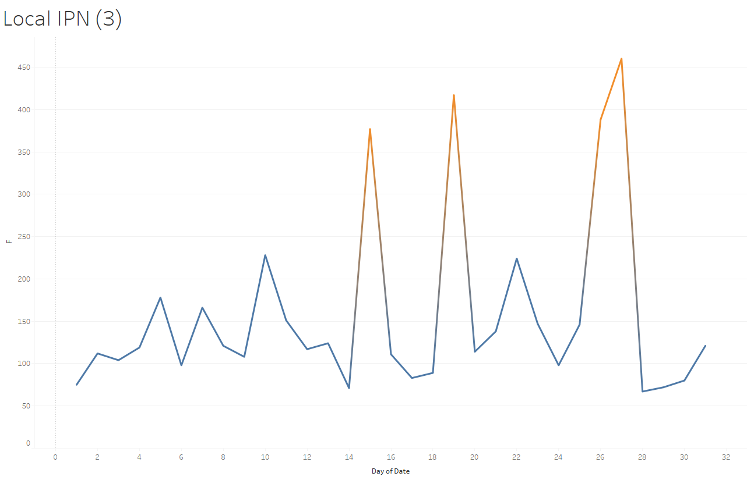
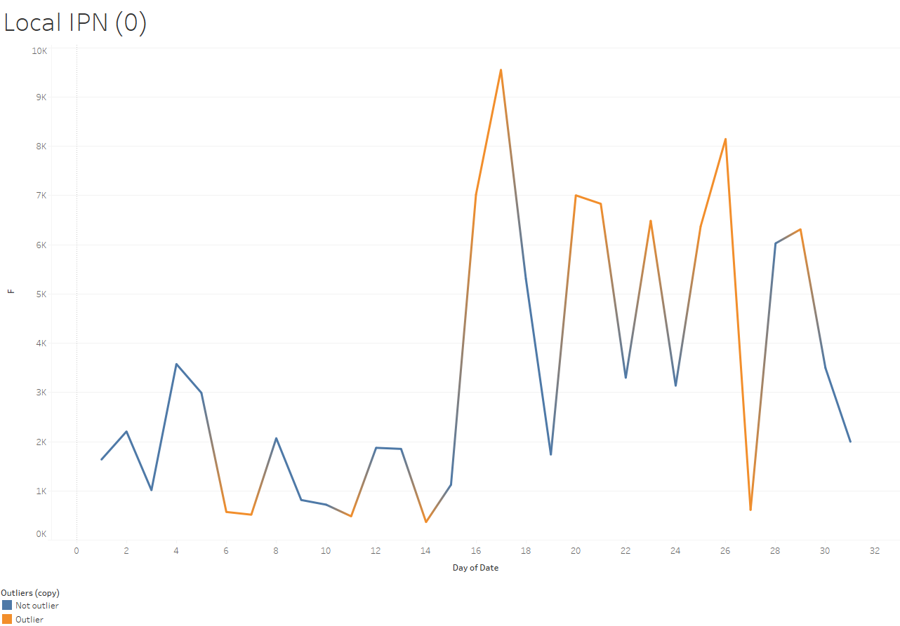
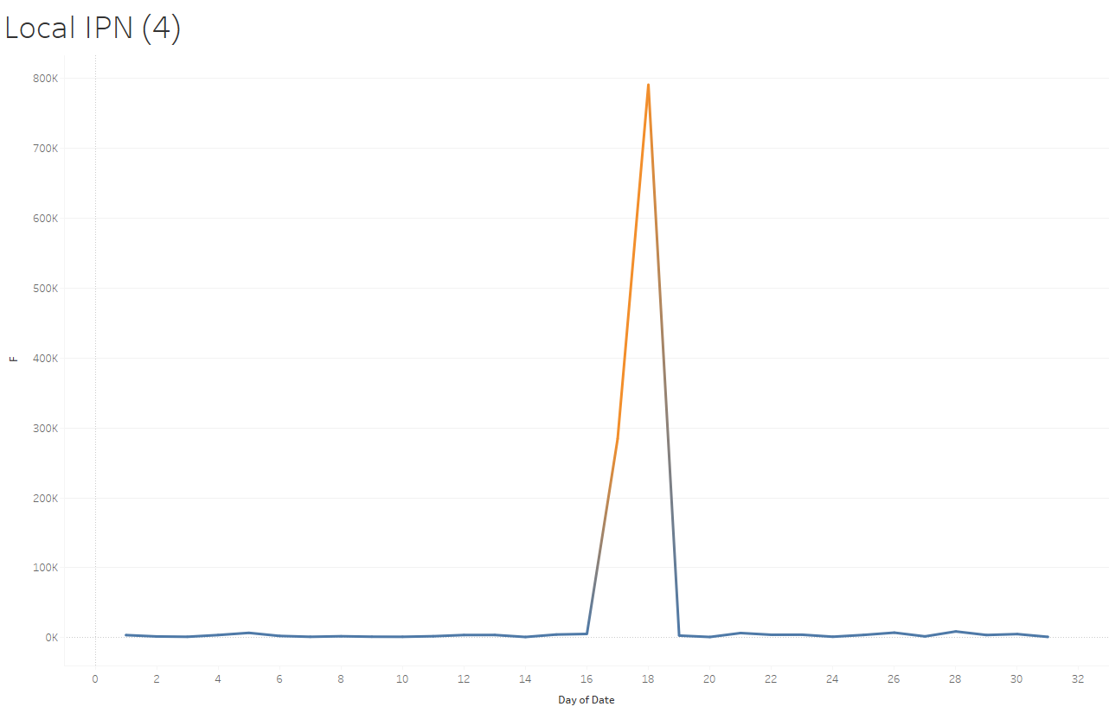
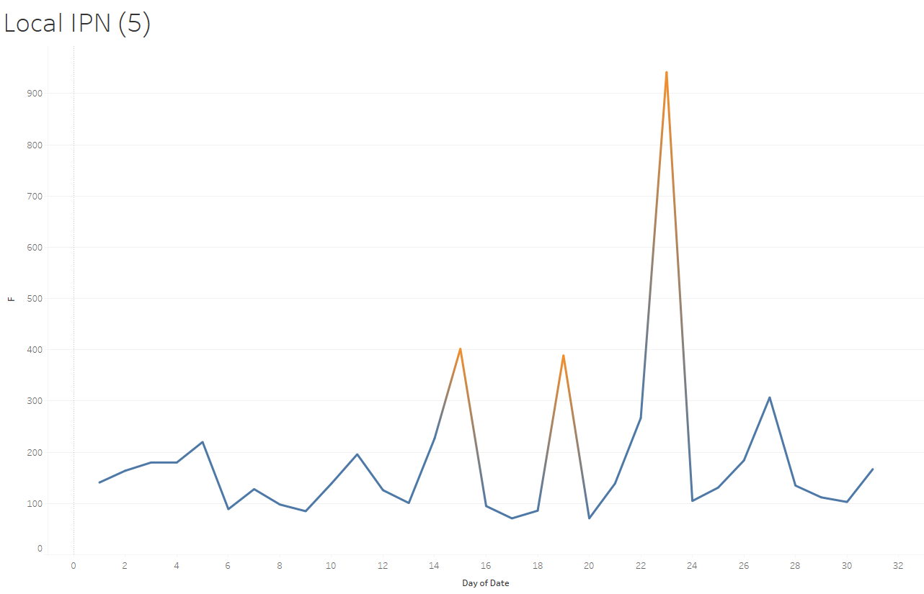
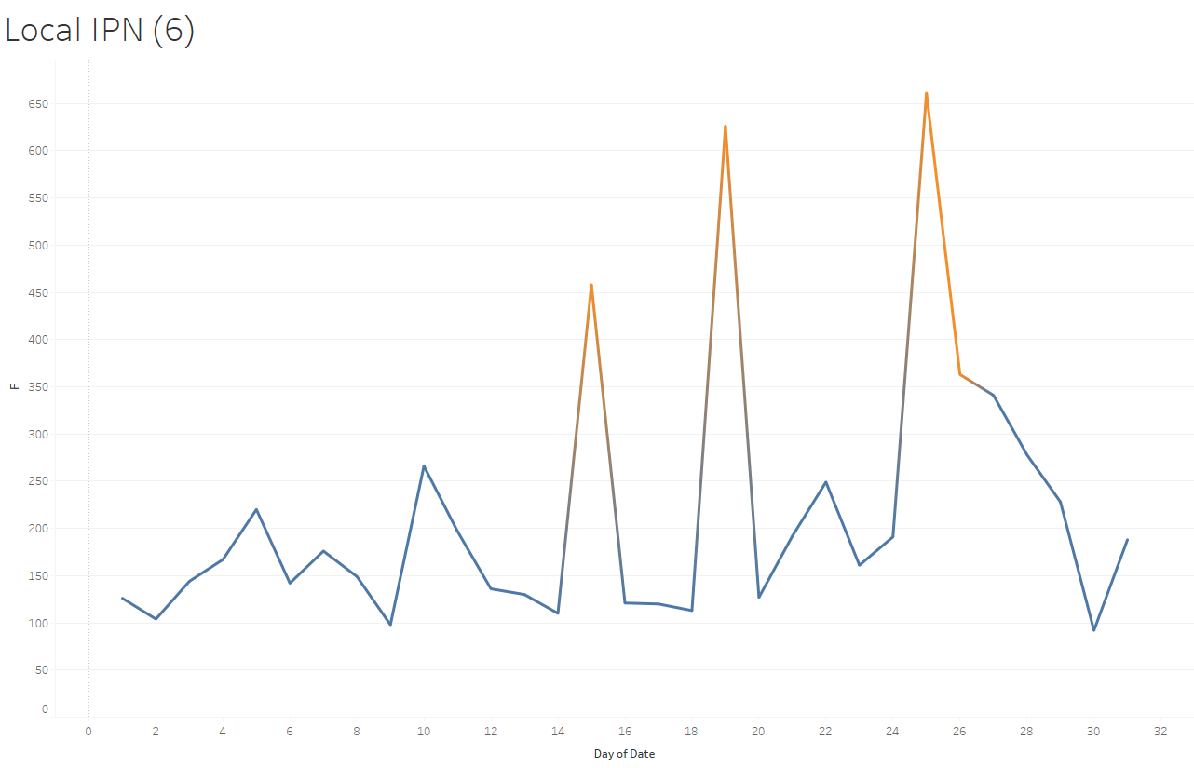
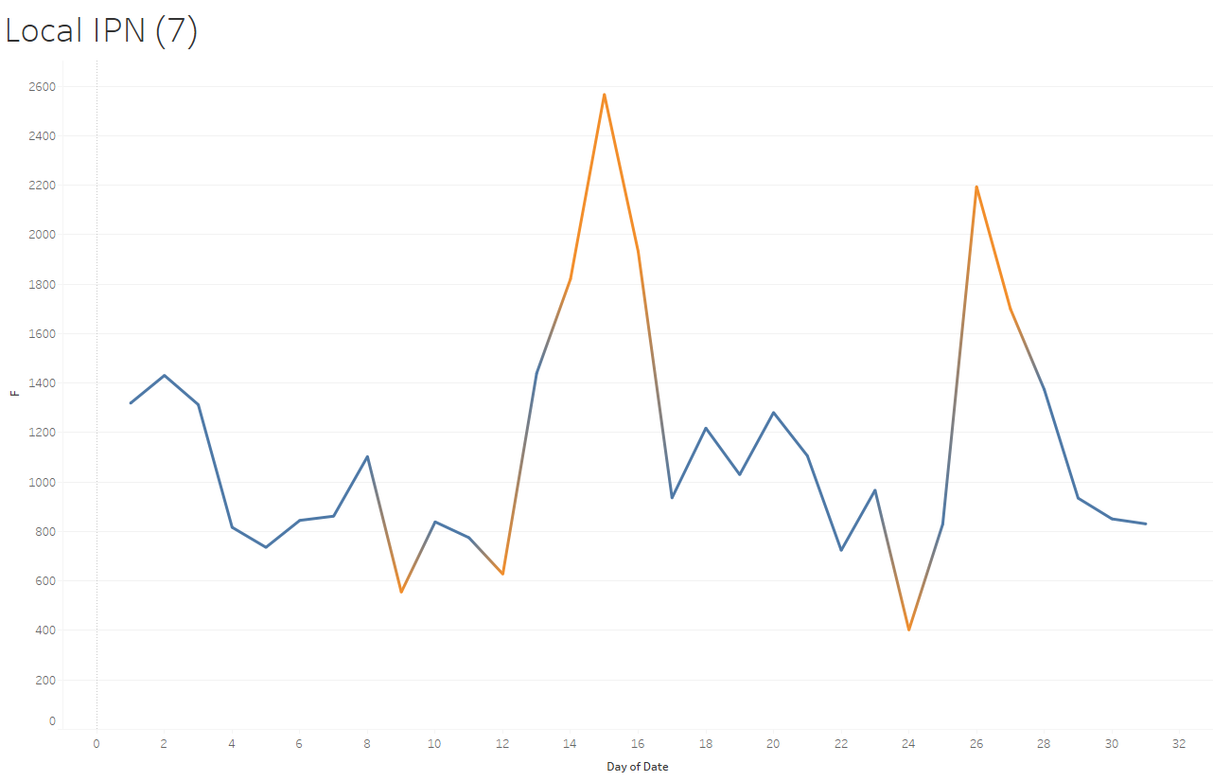
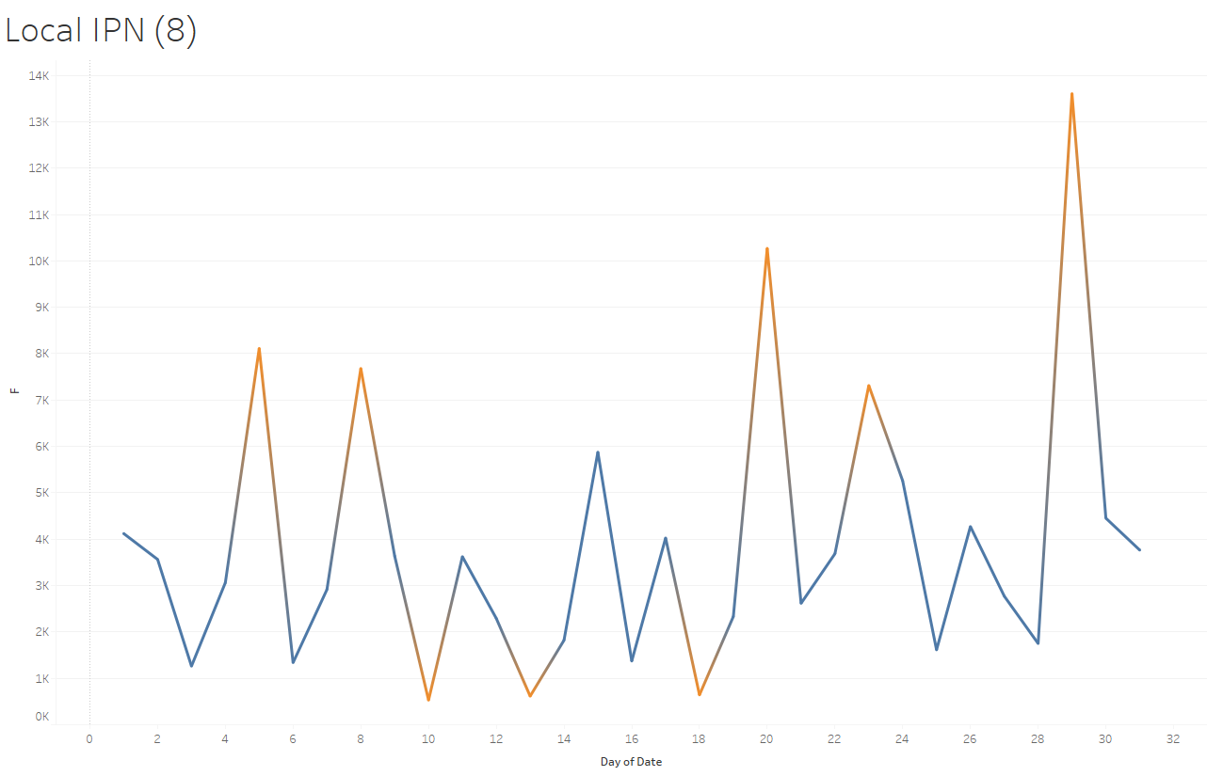
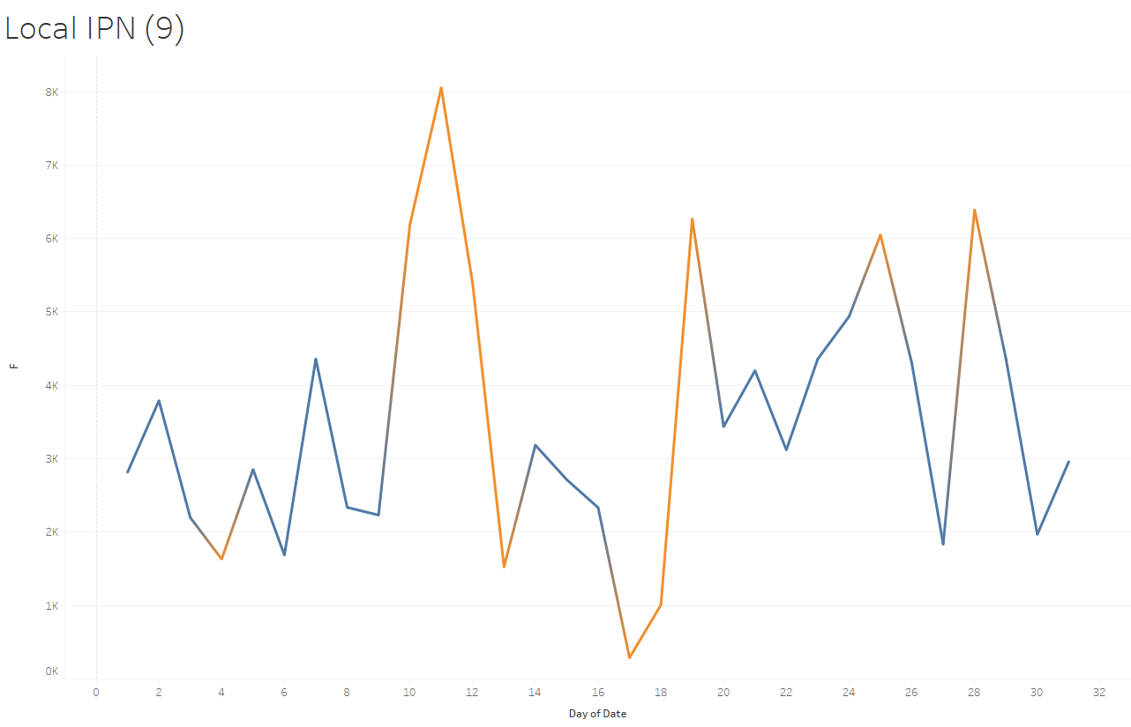
4. Results (7) - Outliers by days and local IPN
Notes:
Differences Data Analyst (DA)vs. Data Scientist (DS)

Slide 14
5. Discussion
Overall: All local IPs have outliers of flows by days but:
Local IP: 4 and possible 1
Date: Sept 17, 18, possible Jul 1 & Aug 1
Remote ASN: 3671
Flow: 274,011 & 784,234
Among the reported odds:
Local IP: 4
Remote ASN: 3671
Date: Sept18, 2006
Flow: 784,234

Slide 15

6. Conclusion
Result
Communication
Process &
Analysis
Data
Collection
Business
Questions
It is very likely that the local IP (4) may have been compromised by bot activity on September 17 and 18. In addition, local PI (1) may also be compromised on Jul 1 & Aug 1. More detailed investigations are required to confirm the compromised bot activity in all local IPs.

Slide 16
Thanks for your time!

